Slide 1
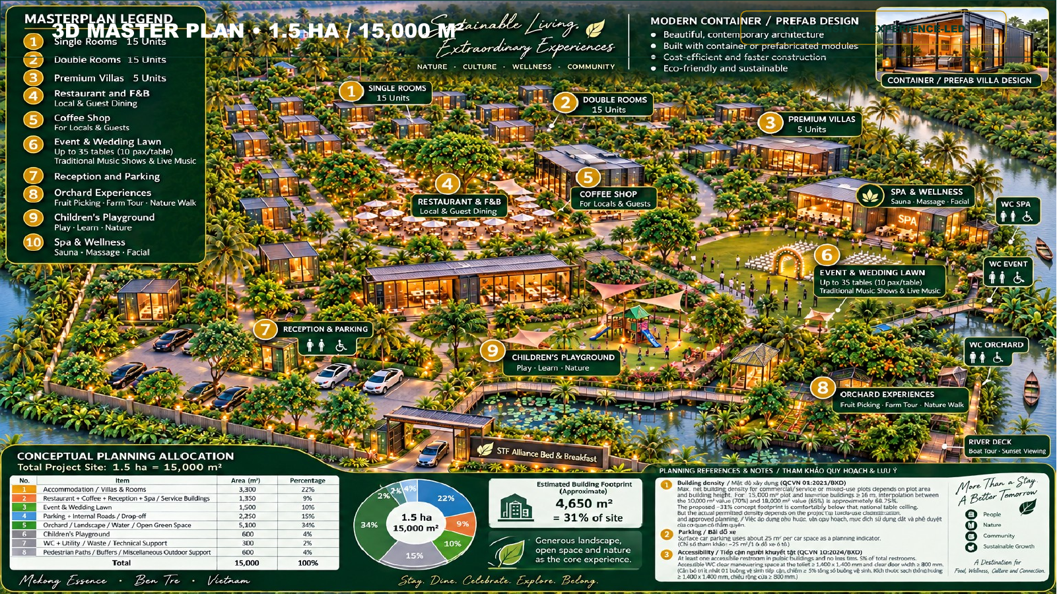
BEN TRE ECO B&B
Build a destination,
not just a room inventory.
Eco B&B + F&B + wellness + events + orchard & river experiences
1.5 ha
35
8
$2.50m
Site
Keys
Revenue streams
Development cost
Investor Teaser • Base Case
BEN TRE ECO B&B • INVESTOR TEASER
1

Slide 2
INVESTMENT SNAPSHOT
Light Asset project with 8 sources of revenue generated
35-key low-density hospitality concept, neo vào cảnh quan vườn nhiệt đới và trải nghiệm ven sông.
$2.50m
$3.70m
$1.08m
12.4%
3.86 yrs
Total development cost
Year 5 revenue
Year 5 EBITDA
Project IRR
Payback
Bao gồm $0.50m giá trị đất
Base case
29.1% EBITDA margin
5-year, unlevered, no terminal value
Cumulative EBITDA basis
Investment thesis
Year 5 revenue mix
• Multiple demand engines reduce dependence on room nights.
• Revenue grows from $1.53m in Year 1 to $3.70m in Year 5.
• Capital recovery occurs during Year 4 on a cumulative EBITDA basis.
~79%
non-room revenue
Events + catering: $1.20m
F&B + café: $1.09m
BEN TRE ECO B&B • INVESTOR TEASER
2

Slide 3
CONCEPT & POSITIONING
“More than a stay” — điểm đến cuối tuần đa trải nghiệm
Đủ gần đô thị để thuận tiện, đủ xanh để tạo cảm giác escape, và đủ hoạt động cho cả khách lưu trú lẫn khách địa phương.
15
15
Single Rooms
Double Rooms
5
F&B
Premium Villas
Restaurant + Coffee
Wellness
Events
Spa & Wellness
Wedding Lawn
Explore
Family
Orchard + River Deck
Children’s Playground
Core promise: NATURE • CULTURE • WELLNESS • COMMUNITY
BEN TRE ECO B&B • INVESTOR TEASER
3

Slide 4
GROWTH & PROFITABILITY
Base case scales through ramp-up, not “super ADR”
Operating leverage expands EBITDA margin as revenue grows faster than fixed payroll and overhead.
Revenue
$1.53m → $2.10m → $2.70m → $3.20m → $3.70m
EBITDA
$0.37m → $0.57m → $0.77m → $0.92m → $1.08m
24.7%
29.1%
1.48×
43.0%
5-year revenue CAGR
Year 5 EBITDA margin
5Y EBITDA / cost
Y5 EBITDA yield
Year 1 → Year 5
Up from 24.5% in Year 1
$3.71m cumulative EBITDA
Y5 EBITDA / initial cost
BEN TRE ECO B&B • INVESTOR TEASER
4

Slide 5
CAPITAL & RETURN PROFILE
US$2.50m total development cost
Funding structure remains to be finalized with investors and lenders.
$0.50m
$2.00m
12.4%
Land value
Non-land development
Unlevered project IRR
20% of total project cost
Construction + fit-out + pre-opening pool
Before leverage and terminal value
Important return caveat
Funding structure — to be finalized
IRR excludes debt financing, taxes, depreciation, maintenance capex beyond the model reserve, working-capital changes and any terminal / exit value. Investor equity IRR will depend on final capital structure, ownership terms and exit strategy.
Sponsor land / equity contribution
External equity / strategic investor capital
Potential debt after legal and lender diligence
Contingency + working-capital buffer to be confirmed
BEN TRE ECO B&B • INVESTOR TEASER
5

Slide 6
EXECUTION ROADMAP
Từ concept đến opening
Sequence is indicative and should be synchronized with land-use, construction, fire safety, environmental and hospitality requirements.
01
02
03
04
05
Legal & design
Capital close
Build & fit-out
Pre-opening
Ramp-up
Land/legal due diligence
Concept → technical design
Investor terms
Debt options
Budget lock
Prefab/container modules
Landscape + utilities
Team hiring
Sales channels
Event pipeline
Soft opening
Occupancy + local demand
Current project status
Land acquisition negotiation + legal feasibility checks; investor outreach in parallel. Formal investment application follows readiness of land/legal and capital discussions.
BEN TRE ECO B&B • INVESTOR TEASER
6

Slide 7
BEN TRE ECO B&B
A compact hospitality platform
with resort-style economics.
1.5 ha • 35 keys • 8 revenue streams
Year 5 revenue $3.70m
Year 5 EBITDA $1.08m
Project IRR 12.4%
Next step
Validate legal / capex detail, confirm capital structure, and prepare investor data room.
Founder & Project Operator: TRỊ NGUYỄN
BEN TRE ECO B&B • INVESTOR TEASER
7

